Slide 1
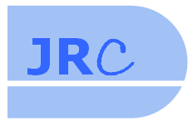
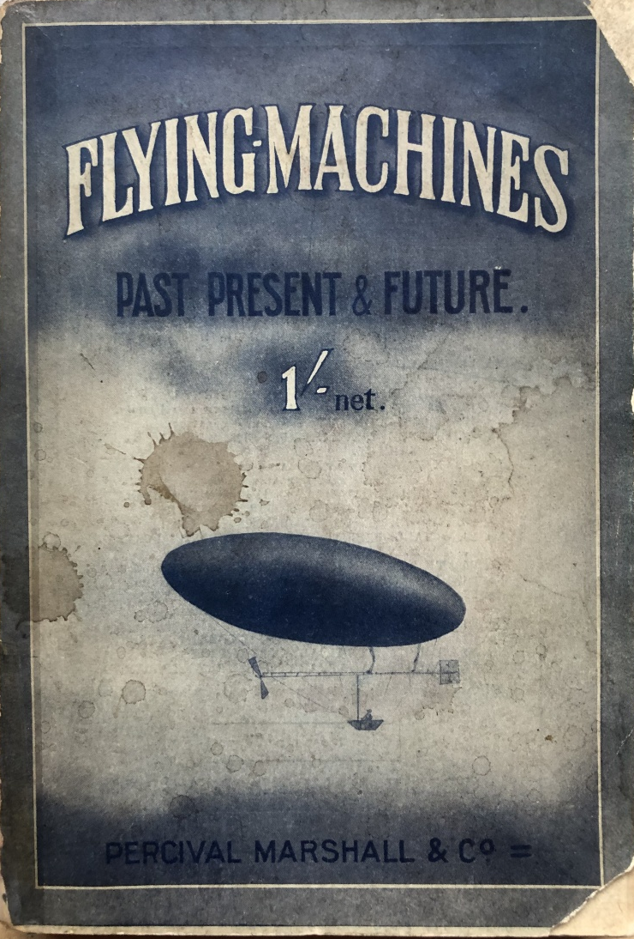

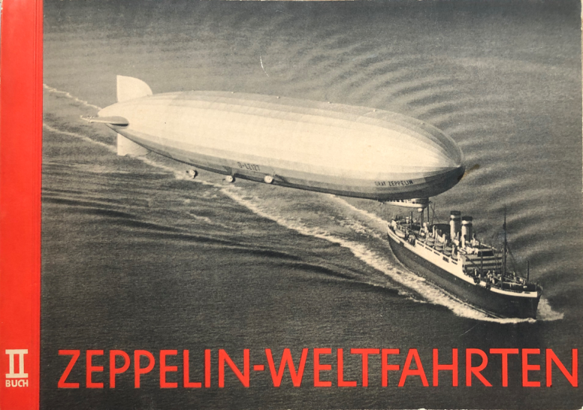
Lighter than air – its history and
current and future potential
Jonathan Roberts, MD JRC Ltd

Slide 3
A BASICS FOR
LIGHTER-THAN-AIR TRAVEL

Slide 4
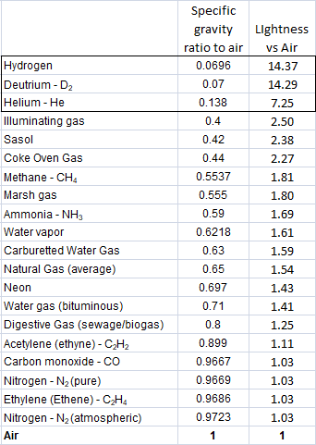
A1 LIGHTER-THAN-AIR Basics
Necessities
What does a lighter-than-air vehicle need?
Lift and Steering:
- Gases lighter than Air (O₂~20%, N~80%, other~0%)
- Displacement of air = aerostatic lift (no power needed
unless hybrid design)
- Directional control in three dimensions
Displacement offset by craft weight:
- Lightweight: strong material technologies needed
“ durable power source & output “ all weather / temperature resistance
“ viable at different altitudes
- Non-commercial load eg fuel, crew, supplies
Economics and other main constraints:
- Practical pay-load, flight distance & duration
- Revenues vs costs
- Aviation regulations, flight / corridor rules
- Operational capabilities, landing and take-off,
turn-round between flights, maintenance
Lighter-than-air gases:
Specific gravity at standard 20ºC temperature and pressure, Air = 1
Consider safety of each gas !

Slide 5
A2 LIGHTER-THAN-AIR Basics
types of craft
Three main types of lighter-than-air craft
Balloon – various means of lifting
- e.g. hot air, or lighter gas into gas envelope
- might or not be powered, but no directional control
except for different wind directions at different altitudes
Dirigible – generally reliant on large-scale volumes of light gas within a containing envelope
- powered + height / direction controls – dirigéable (Fr.)
- three main subsets:
non-rigid (gas-bag inflated at pressure)
semi-rigid (with firm keel)
rigid (gasbags within strong frame)
Hybrid – combination of aerostatic lift (no power needed) and power choices requiring some aerodynamic lift (as with a plane or helicopter):
- shape of envelope may help lift, with forward momentum
- mechanical assistance e.g. vertical rotor, vector engine

Slide 6
A3 LIGHTER-THAN-AIR Basics
DISPLACEMENT & FLIGHT PURPOSE
For ‘true’ lighter-than-air, the keys are scale of displacement and extent of flight operations
Displacement: Scale defines extent of lifting capability:
- craft to lift itself by displacing air without mechanical
assistance
- ability to lift a supplementary load – the ‘pay’-load
Operating scope:
- depends on project objectives and design of craft
(whether designed specifically or adapted for purpose)
- may vary by height required, or distance / length of time

Slide 7
A4 LIGHTER-THAN-AIR Basics
CRAFT DESIGN & SUPPORTING INFRASTRUCTURE
Important to consider craft design and supporting infrastructure in the context of intended purpose:
- Can there be multi-purpose design options?
- Is it more viable to design airships (like most vehicles)
for specific combinations of use and likely revenues?
- What will be the pay-back period for various ‘pay’-loads?
- Potential scale of development work / new infrastructure
could be considerable e.g. number / location of airship
bases – who pays?
- Are there ‘rich daddies’ who can afford ‘one-offs’?
Potential funders:
suggestions:
National governments
Armed services for their uses
Magnates:
eg Media owners
Enthusiasts
Crowd funding / equity
Property owners
Backers of remote projects
Scientific institutes
Tourism businesses

Slide 8
B HISTORY: 1783 to 1940

Slide 9
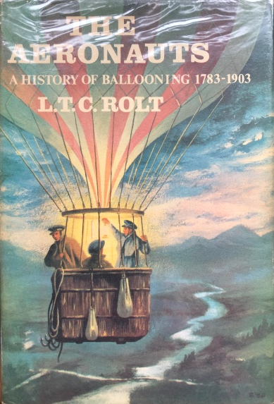
B1 HISTORY: 1783 TO 1940
GETTING ANYTHING NAVIGABLE ALOFT
Nothing flew until 1783 – except Icarus?
Ballooning invented – as hot air rises
Early uses including scientific discovery and military tethered observation points
But for travel only where the wind took you
...yet man desired mastery of the air
1852 first (brief) steam-powered flight, Fr
1884 first (brief) electric motor flight, Fr
1897 first (blew-up) petrol-engine flight, Ge
Known issues, main defects and needs:
- reliable power, better power-weight, good propeller
- streamlined gas envelope
- steering (rudder, elevators)
- height and trim control (ballonets etc.)
- keel if you want to carry a control cabin / more
.

Slide 10


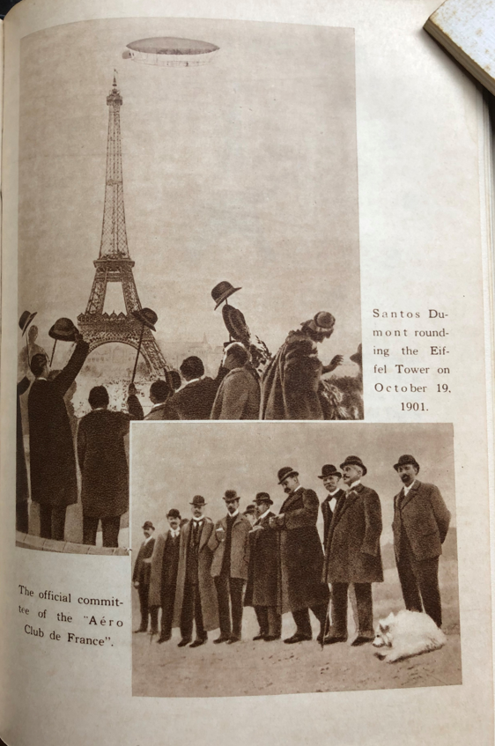
B2 HISTORY: 1783 TO 1940
A 1901 SUCCESS, AND POWERFUL PUBLICITY
Alberto Santos-Dumont arrived in Paris in 1897, from Brazil
Son of wealthy coffee plantation owner
Deliberate early experience with ballooning
Then attached advanced petrol engine to a lengthened gas balloon, and succeeded...
- More prototypes, soon familiar flying down Paris streets and literally ‘dropping in’ for a coffee, etc! Vast crowds!
Entered and won the Round the Eiffel Tower challenge on 19 October 1901 (125,000 franc prize)
Aroused more enthusiasm for powered flight than anyone before him
- Then switched to love of aeroplanes
but thanks to Santos Dumont, airships had come of age
.

Slide 11
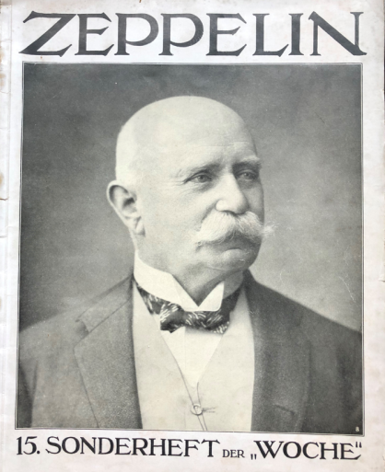
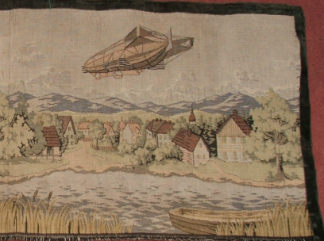
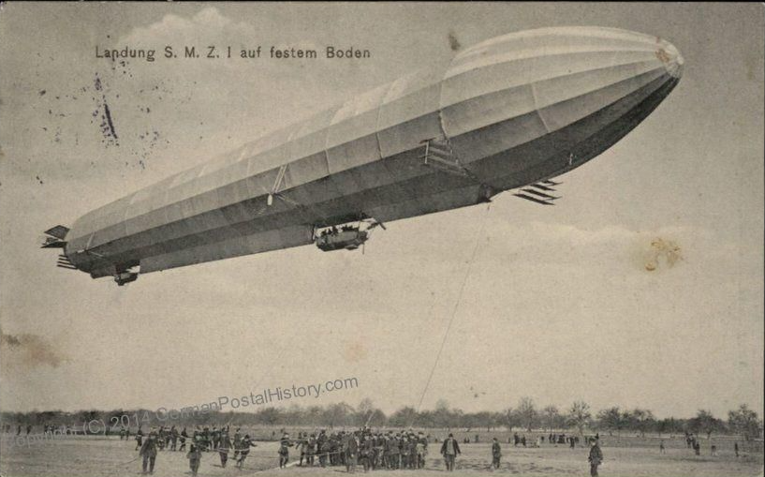
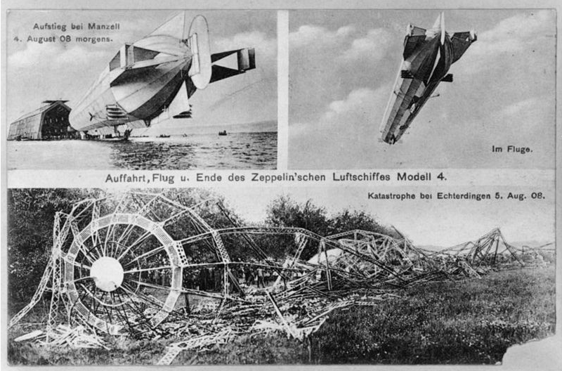
B3 HISTORY: 1783 TO 1940
GERMAN DOGGEDNESS AND CROWD-FUNDING
Parallel enthusiasm, for a different, rigid airship design, offered by Graf Ferdinand von Zeppelin
1900 creation of a 120 metre long airship!
- This when no aeroplane had yet flown...
- ‘LZ1’ berthed in a floating hanger on Lake Constance
LZ1 failed, however the Graf ran public lotteries, built more prototypes
- flew them on publicity trips round Germany
- stirred large scale public support
- secured Kaiser and High Command backing by 1908
- founded first airship airline in 1909 (DELAG)
-1911-13 along with journalist and psychology graduate Dr
Hugo Eckener promoted airship travel with four airships
By 1914, nearly 10,000 people had been carried safely 270,000 km (170,000 miles)
- But alliance with German military (backed by Graf
Zeppelin) meant Zeppelins would have new meaning
during and immediately after World War One.
.

Slide 12

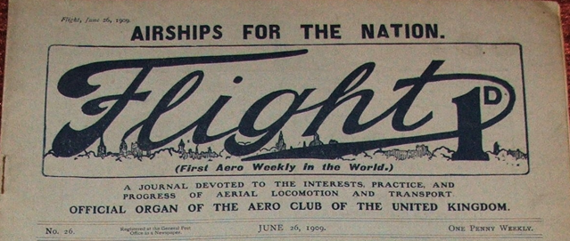
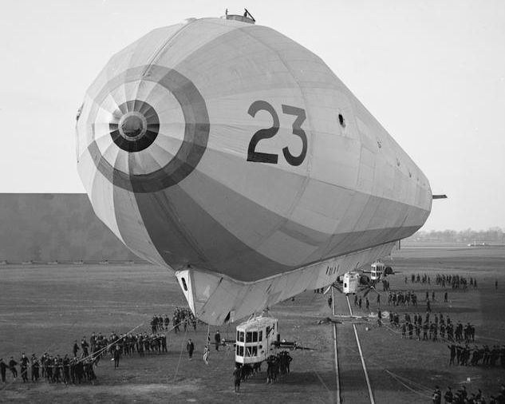
B4 HISTORY: 1783 TO 1940
BEYOND FRANCE and germany...
UK late to the scene in 1909, mainly caused by Flight magazine castigation
and other media / political coverage
- Mostly military in response to Germany (and France!)
- Rivalry between Royal Navy and British Army about
airship design and development. Civil interest also: e.g.
Kipling’s ‘With The Night Mail’ – UK to Quebec in 2000
Italy and Russia also serious, again mainly military except for well-off enthusiasts
Mainly a European love affair
Parallel to civil and military enthusiasm for aeroplanes
Germany the technical leader, able to
mass produce rigids by 1914
- But carrying capacities remained limited...
.
Most British airships were non-rigids, however from 1915 some rigids were also built, emulating German design:

Slide 13

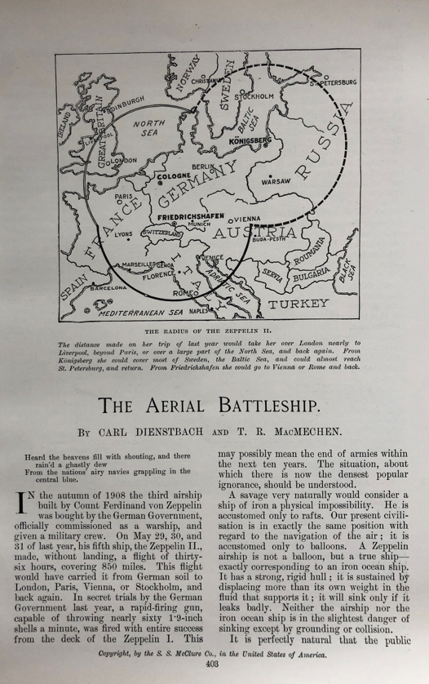
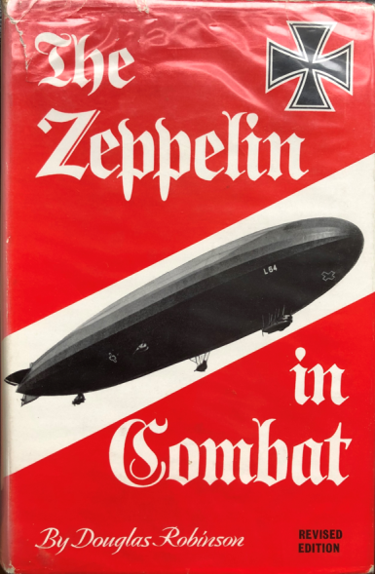
B5 HISTORY: 1783 TO 1940
GREAT WAR / WORLD WAR ONE...
Scope for airship use:
- Battlefield observation / bombing
- Reconnaissance supporting Battle fleets
- Long range bombing of enemy cities /
military centres / ordnance sites
- Supply logistics over major distance (e.g. L59 to German
East Africa), also paratroop dropping (not yet devised!)
German strategic misuse of airships
- Bombing ineffective but antagonised Britain
- Harmed subsequent post-WW1 airship development:
1918 and 1919 aftermath with Versailles treaty limits
- UK, France and Italy did technology grab from Germany
UK to capitalise on airship development?
- Prospects of good US orders
.

Slide 14
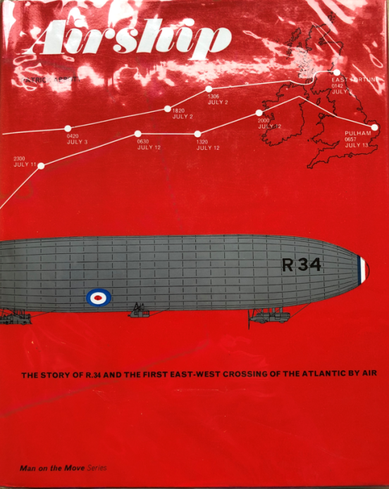
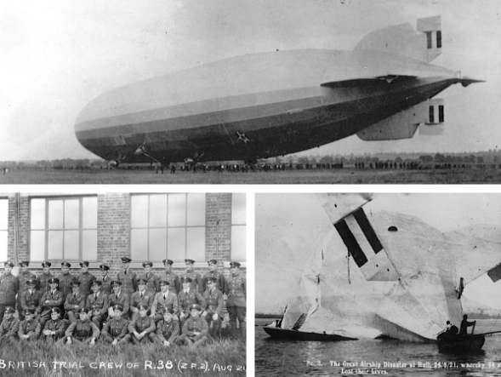
B6 HISTORY: 1783 TO 1940
Act Two: enter the wishful giants
International wanderlust post-WW1
Giant rigids seen as way forward
- Planes still short flight distance and unsafe
Main opportunities
- Britain to its Empire
- France and its colonies
- USA (continental scale, for defence and travel)
- Exploration (e.g. Arctic)
- Germany wanted to, but constrained by Versailles treaty
- Russia also wanted to, but bigger internal issues
Britain relied on wartime German designs
- R34 successful flight to Canada in 1919
- Contractual deal with USA for ‘guard’ airships - but didn’t
understand stress limits – R38 Humber disaster in 1921
- France and Italy also struggled
(e.g. disasters with Dixmude, Roma)
.

Slide 15
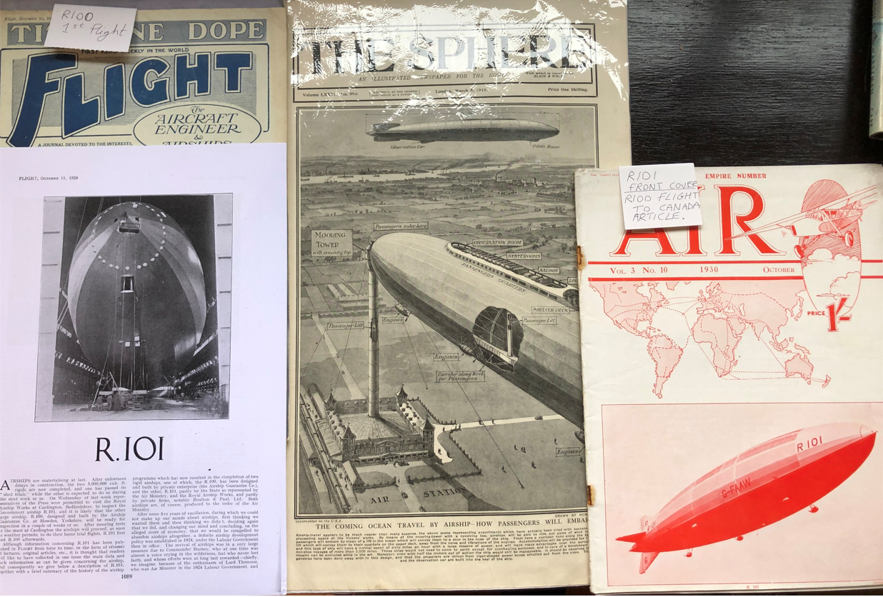

Slide 16

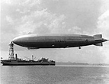
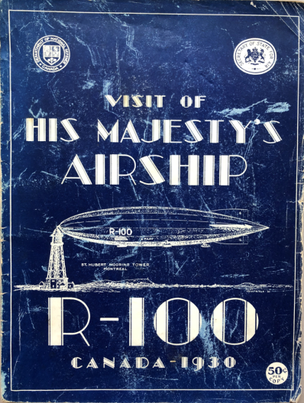
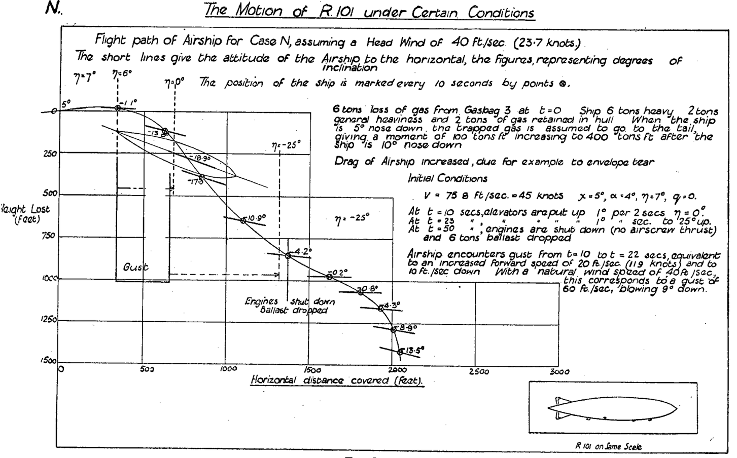
B7 HISTORY: 1783 TO 1940
Act Three: HUGO TRIUMPHANT - NEARLY
Hugo Eckener and the winning combine: Zeppelin – Goodyear – Hearst
- Germany negotiated tech. transfer to USA (Goodyear)
incl. brilliant designer Dr Arnheim (USS Akron/Macon)
- ‘ZR3’ = war reparations to USA > ‘USS Los Angeles’
- enabled restart on Zeppelin development
- led to ‘Graf Zeppelin’ the world-circling success and
international publicity generator, also backed by Hearst
- itself only a pioneer for a new generation of giants –
the ‘Hindenburg’ class (LZ129, then LZ130 and LZ131)
Meanwhile UK succeeded with R100 (mostly) but R101 a disaster in every way
- UK gives up Imperial airship dream
Hindenburg inter-continental giant
and theoretically profitable design
- Dwarfed by 1930s politics killing off helium
option, leaving hydrogen (as before)
- 1937 disaster at Lakehurst - denouement for
German airships (though building continued)
.

Slide 17
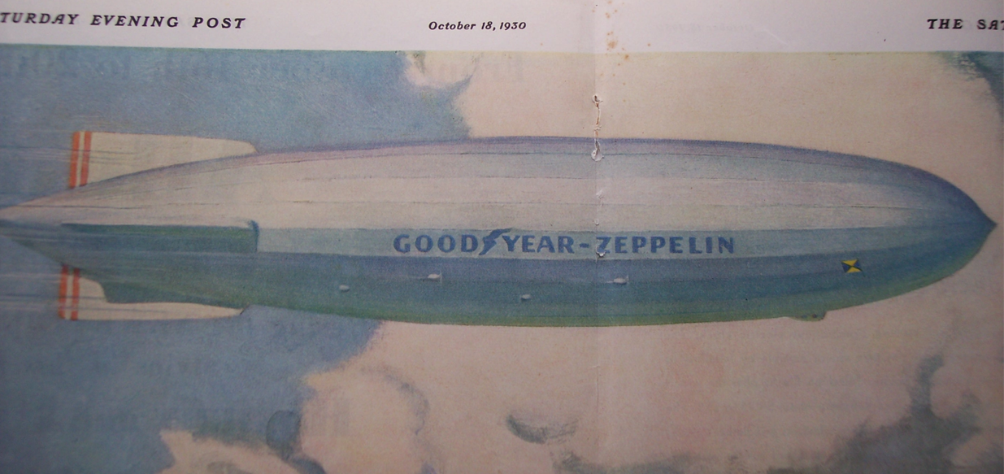
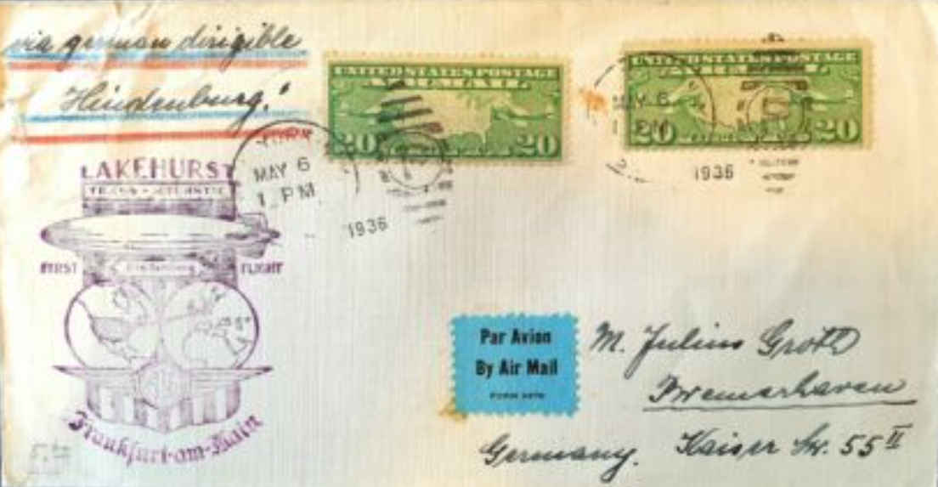
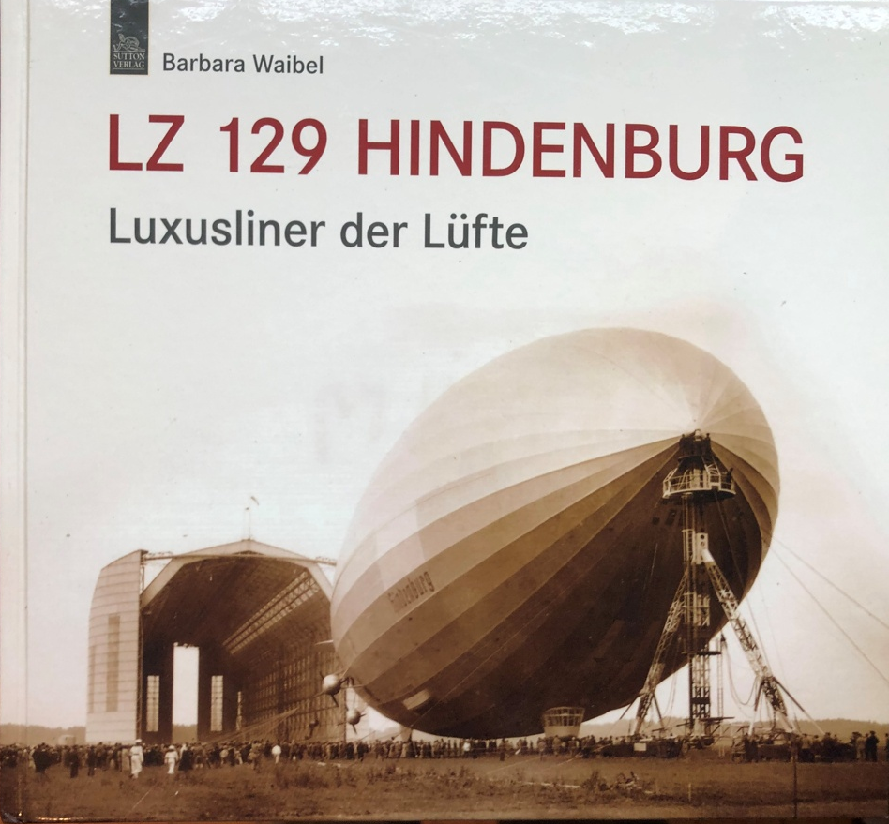
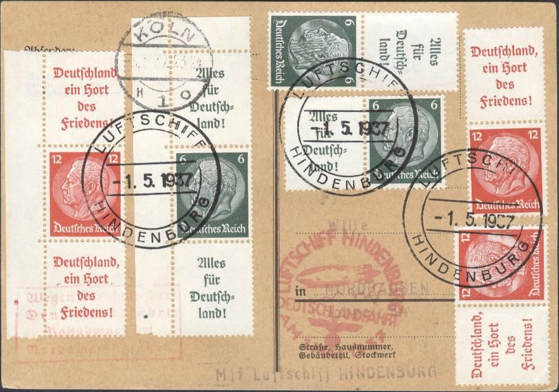


Slide 18
C CURRENT ERA FROM 1940

Slide 19
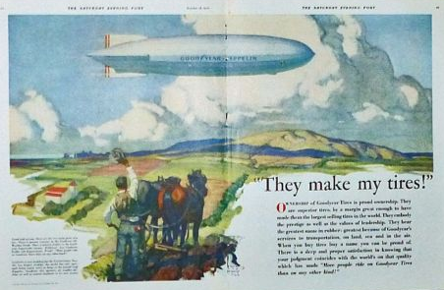
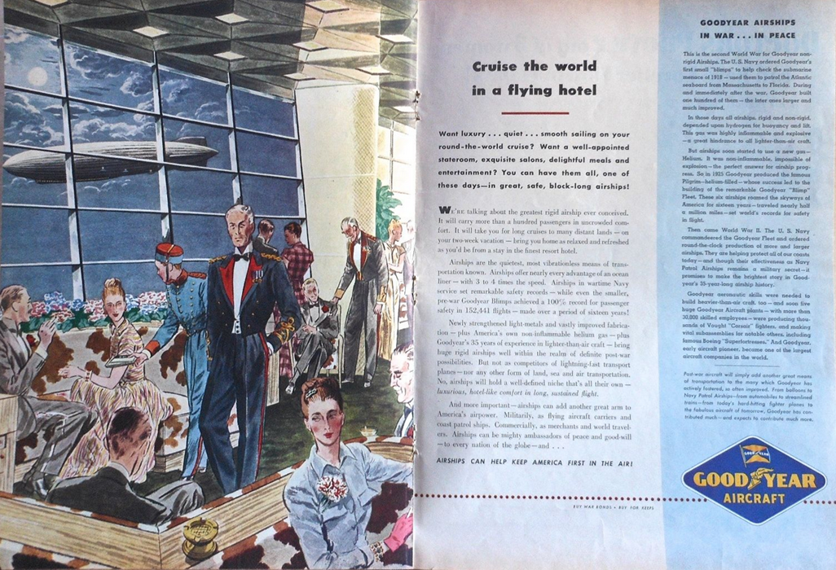
C1 CURRENT ERA FROM 1940
SO WHAT WAS LEFT FOR AIRSHIPS TO DO?
US Goodyear remained sole proponent of large rigids, but for what use post-WW2?
Large double-spread promotions in WW2
- continental-scale airship travel for well-offs
- also promoted Goodyear Navy ‘blimps’ and
general use of rubber (eg car tyres)
But planes became trans-continental in capability during the war
- e.g. Atlantic supply corridor
- airplane infrastructure expanded
- long runways, trans-continental
airports (> 1943 Heathrow design)
Plane speed, flight duration,
reliability & capacity overtook
remaining merits of scheduled
travel by long-distance airship
.

Slide 20
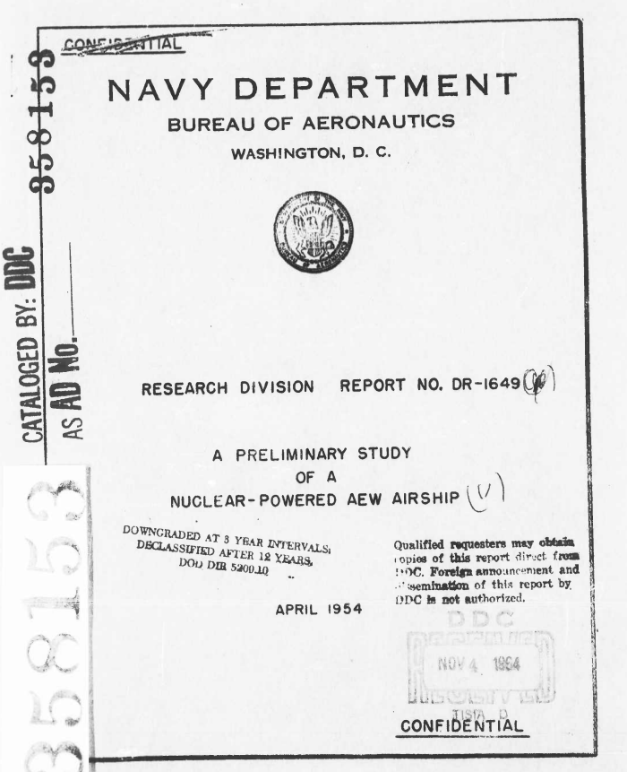

C2 CURRENT ERA FROM 1940
A RECORD OF PROVIDING NICHE SERVICES
Re-start by considering purposes
Intrinsic advantages of lighter-than-air:
- Hover / aloft for extended periods, plus research and
monitoring platform:
> coastal patrol
> scientific and surveying research in remote areas
> access to remote installations incl. oil rigs
> fisheries protection
> anti-submarine warfare
> aerial early warning
> minesweeper
- Tourist travel and aerial advertising:
> e.g. sightseeing
- Landing / takeoff in restricted zones, e.g. city centres
Results are potential requirements for specialist airships, mostly small scale:
- ‘Blimps’ as used by US for coastal patrolling until 1970s
- Long duration aloft, long range?
- Even nuclear power has been considered for that
.

Slide 21
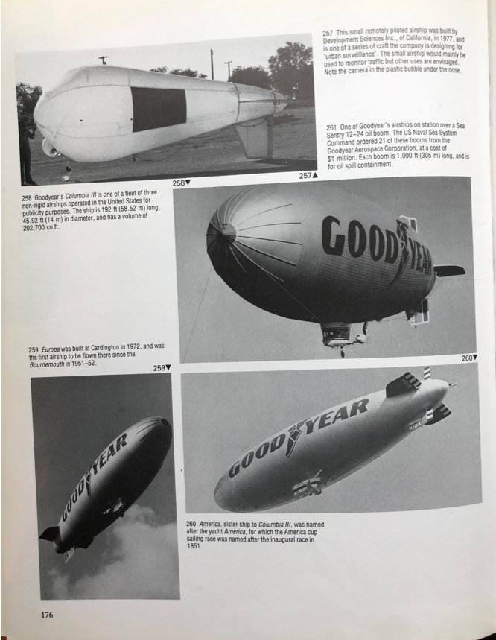
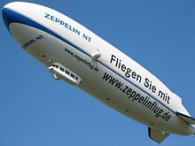
C3 current era from 1940
EXAMPLES of Airship use since 1940
Less dramatic designs than
nuclear power have been the
order of the day
⬅ Goodyear Blimps
Zeppelin Neue Technologie
(see the vector engines)

Slide 22
D TODAY’S OPTIONS

Slide 23
D1 TODAY’s options
INCREASING Competition for niche services
Greater range of competitor choices
- extended range of helicopters
- automated drones for hovering and delivering
- satellite-based surveillance systems
- over-the-horizon radar
(noting some may still need surface intervention,
when the airship could still be relevant)
Airship operating and servicing costs, crewing requirement
- a negative, though whole-life costs might be comparable
- viability will depend on specific applications e.g. pricing
for unique tourism experience can afford costs
Airship developments have responded with new designs to offer more versatility
- new more durable materials e.g. plastics and neoprene
- lighter more powerful engines, modern electronics
- hybrids combining aerostatic & aerodynamic principles

Slide 24
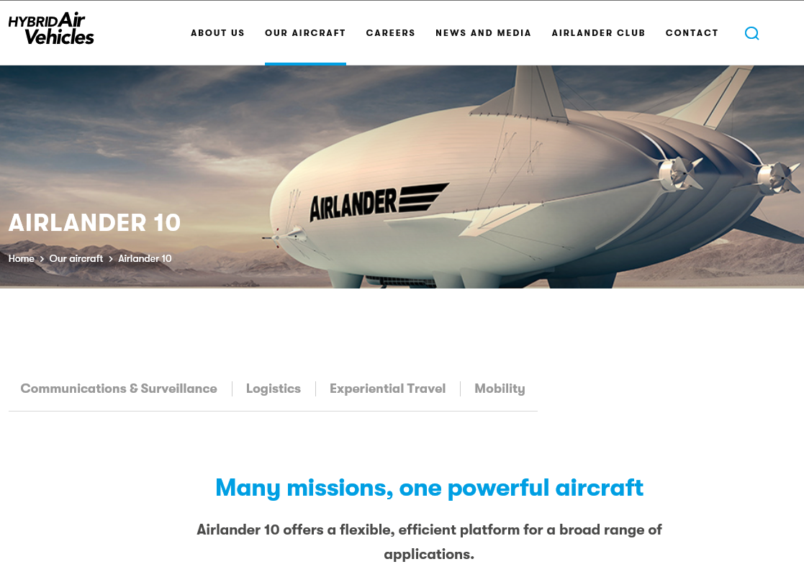

Slide 25
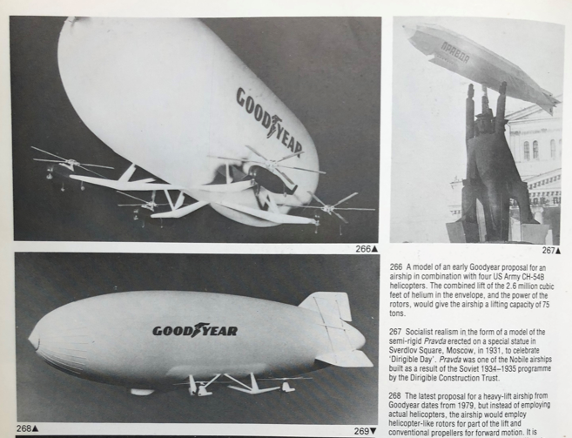
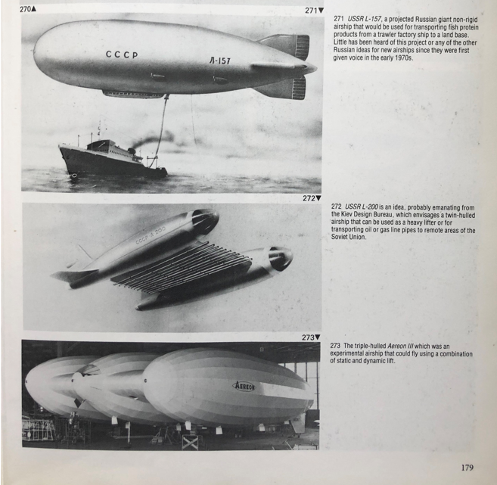
D2 TODAY’s options
proposals for HYBRID DESIGNS
Little point in devising hybrids unless clear economic purpose for them
Most hybrids proposed to greatly increase carrying capacity and/or versatility, with aerodynamic extras to achieve that
Examples include:
- heavy lift airships for bulk freight carriage from remote
terrain (e.g. Siberia)
- aerodynamic shape to increase lift with forward
movement
- vectored engine for ease of landing / take-off with
minimum airspace requirement at airports, and
manoeuvring / lifting at target destination
(or rotor engines, helicopter-style, to achieve the same)
- vectored engines can increase versatility of a single
design, to improve commercial take-up for different
carrying purposes and assist profitability
.

Slide 26
E TOMORROW

Slide 27
E1 TOMORROW
FActoRS FOR THE NEXT DECADES
Sustainability > Aerostatic lift does not need fossil fuels
- Carbon penalty charges could help airship economics
- Land take by airports could reduce with hybrid craft
- Land take by surface transport might be lessened
- Noise benefits (modern airships are very quiet)
- Political imperatives with Net Zero and decarbonisation
- Can airships assist ‘Real Zero’? Use jet streams?
Changes by / to the competition
- Electric powered large aircraft?
- Fuel issue is mainly about taxi-ing, and takeoff to cruise
height – can this be mitigated adequately?
- Freight / mail haulage in holds of fossil fuel-using planes
risks being targeted as unsustainable, can airships
invent for themselves a substantial logistics freight rôle?
Public desires and commercial changes
- Will speed continue to be valued so highly 30 years on?
.
https://ecofriend.com/20-sustainable-airships-promising-a-clean-future-of-transportation-and-surveillance.html
https://www.youtube.com/watch?v=5weItJuMbKs
https://phys.org/news/2019-08-case-airships.html
https://www.sciencedirect.com/science/article/pii/S2590174519300145
https://isopolar.com/sustainable-transportation-airships-versus-jet-airplanes/
https://undecidedmf.com/episodes/why-the-airship-may-be-the-future-of-air-travel

Slide 28
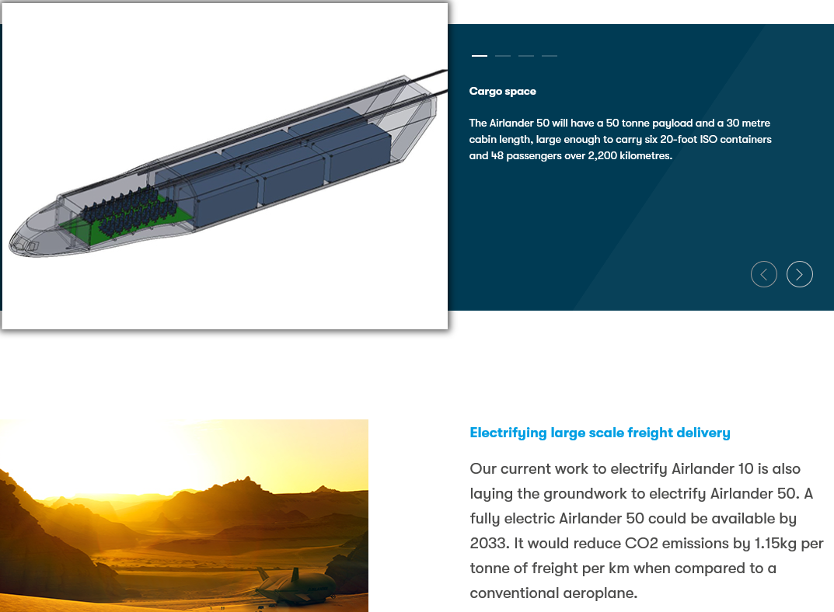

Slide 29
E2 TOMORROW
VISIONARY THINKING
Airships were created with the vision (and investment) of a few, such as Santos Dumont, Graf Zeppelin, Hugo Eckener
The thought of a vessel as large as a supertanker or as small as an HGV, floating past in the sky, will continue to attract visionaries (and probably offend others!)
In the 1920s, such expectations were the norm, not the odd. Serious writers and planners saw them as part of the future
We can’t predict everything during the next decades. Collectively we are on a journey of exploration, to achieve better balance between human activity and our planet
To conclude, here are two visions:-

Slide 30
Antoine de Saint-Exupéry
Quand tu veux construire un bateau,
ne commence pas par rassembler du bois, couper des planches et distribuer du travail,
mais reveille au sein des hommes
le desir de la mer grande et large

Slide 31
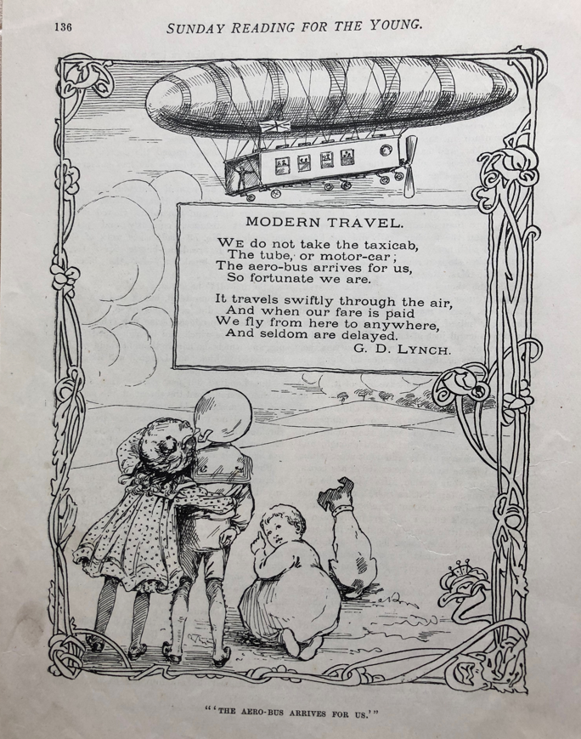

Slide 32
Questions ?
jr@jrc.org.uk
www.jrc.org.uk

